Slide 1
WHY NOT SPEND YOUR SUMMER AT THE SEA?
YOUR
SUMMER
JOB
2019
IN GERMANY
ON THE COAST OF
NORTHERN GERMANY
LIVING
AND
WORKING
ANTJE
SCHLEEDE
~
EURES
Advisor

Slide 2
(ASSISTANT)
COOKS
WAITRESSES
WAITERS
WANTED
HOUSE-KEEPERS
ENTER-TAINERS
ICE CREAM SELLERS
AND OTHERS…

Slide 3
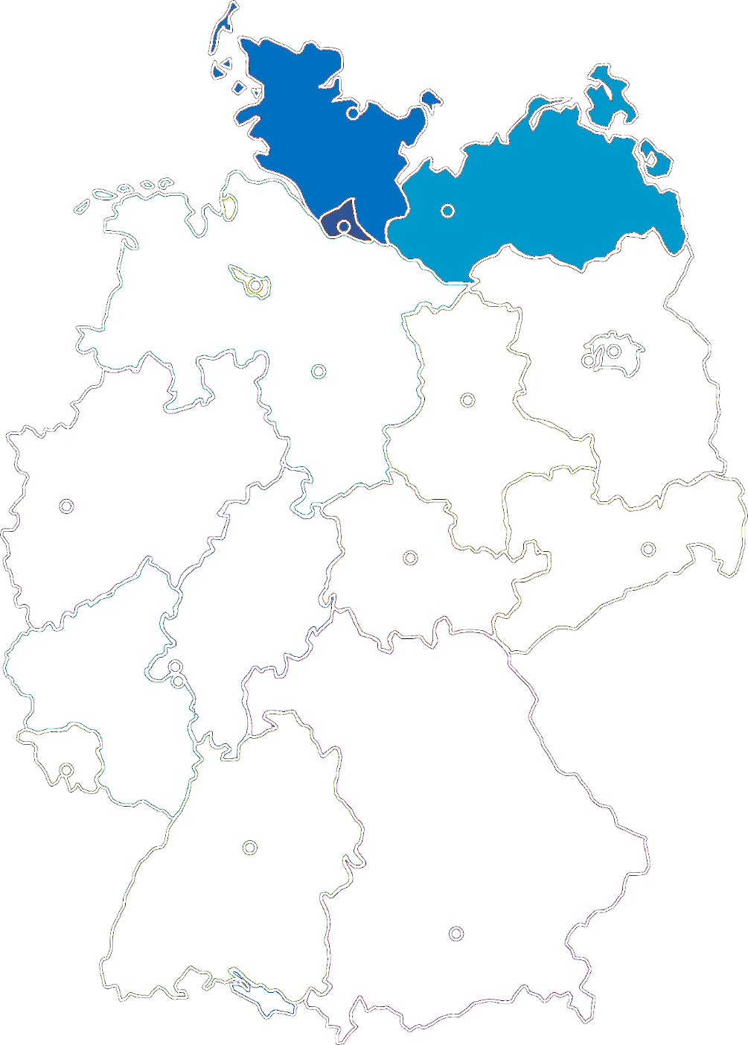
WELCOME TO NORTHERN GERMANY
MECKLENBURG-
WEST POMERANIA
SCHLESWIG-
HOLSTEIN
SCHLESWIG-
HOLSTEIN
HAM-
BURG
The „real“ north
The happiest people in Germany
BERLIN
www.schleswig-holstein.de
MECKLENBURG-WEST POMERANIA
The sunniest summer
The longest coast line of Germany
www.mecklenburg-vorpommern.de
Notes:
Küstenlinie, Sonnenstunden
Glücklichsten Leute
Links
SH
at the top of Germany ☺ - 652 hours of sunshine (summer 2015) - The happiest people in Germany
MV
The unique mixture of nature, culture and urban flair - The longest coast line of Germany (2,000 km) - More than 2,000 lakes

Slide 4
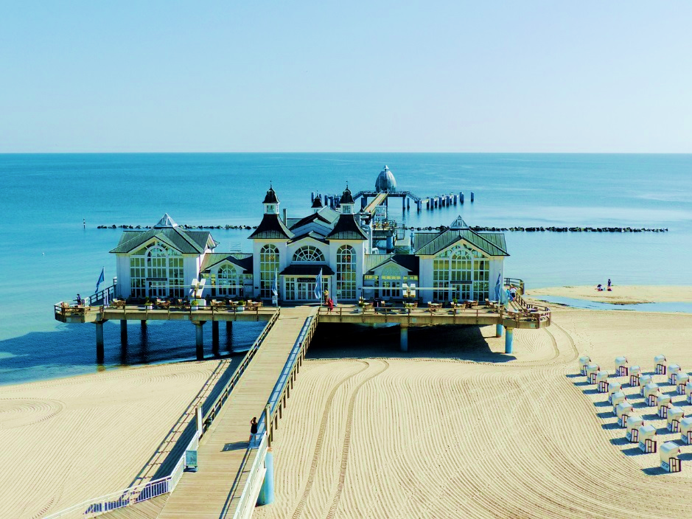
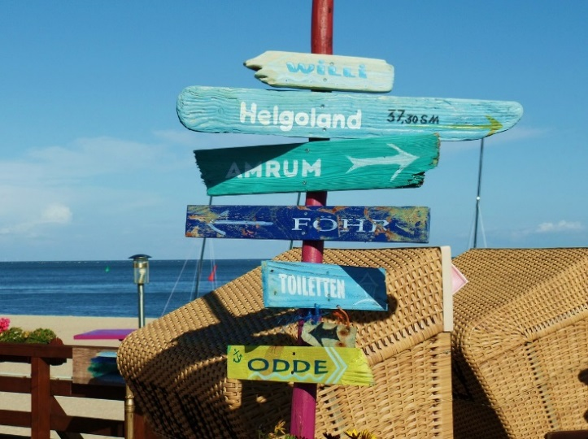
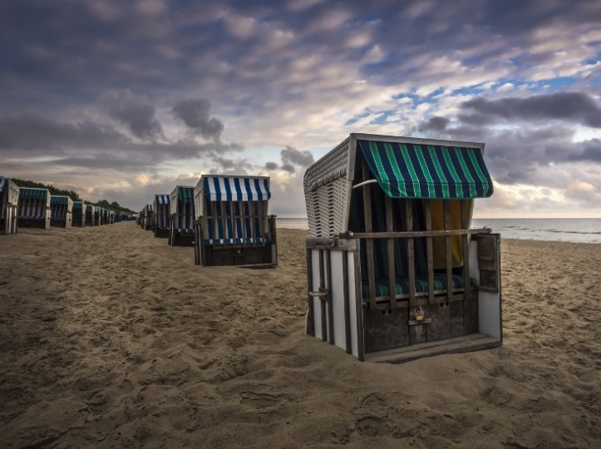
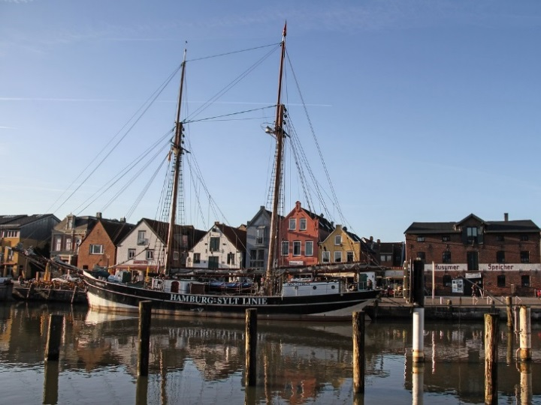
PLACES
OF WORK
ON NORTH SEA ISLANDS
(e.g. Föhr, Sylt and Amrum)
ON BALTIC SEA ISLANDS
(e.g. Rugia, Fischland-Darß-Zingst, Fehmarn, Usedom)
In villages ALONG THE SHORE OF BOTH BALTIC AND NORTH SEA

Slide 5
REQUIREMENTS
(GOOD) KNOWLEDGE OF GERMAN
MINIMUM AVAILABILITY
OF 12 WEEKS
WORKING EXPERIENCE
EUROPEAN CITIZENSHIP OR MATRICULATION AT AN EU UNIVERSITY

Slide 6
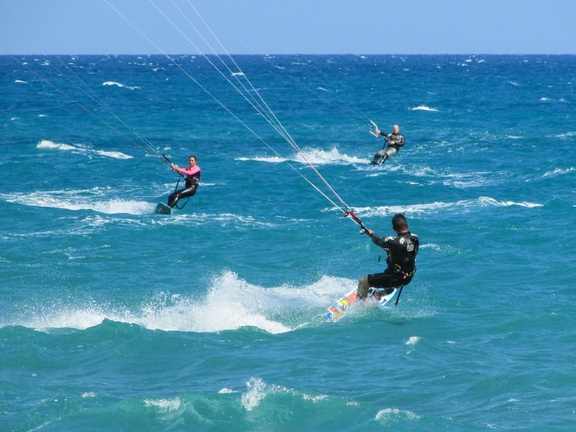
FUN
SHIFTS are the rule. WEEKEND WORK likewise.
40 – 48 WORKING HOURS / week
SUN
You‘ll RUN AROUND a lot during shift.
BEACH
STRESS, especially on sunny weekends
YOU CAN
INCREASE YOUR
SALARY THROUGH
TIP
SUBSTANTIALLY
NEW
PEOPLE
Notes:
Shifts are the rule, also at weekends
40-46 working hours / week
You’ll run around a lot during shift
Stress, especially on sunny week-ends, when many day tourists arrive
Tip is quite common in Germany, so through good service you can increase your salary substantially

Slide 7
THE OFFER
MINIMUM HOURLY
WAGE OF
9,19 € + TIP
ROOM & MEALS
FOR FREE OR AT VERY LITTLE COST
LEISURE TIME: BEACH, NATURE, HAMBURG AND BERLIN

Slide 8
FORMALITIES I:
FROM GROSS TO NET WAGE
WHAT TAXES
YOU HAVE TO PAY
WHAT YOU PAY FOR
SOCIAL INSURANCES
Income tax | 14 - 45 %* depending on wage and marital status
Church tax | 9 %**
Solidary surcharge | 5.5 %**
*...of your taxable income **...of the income tax contribution
Pension | 9.30 %*
Health | 7.3 %* + [0.3 - 1.7 %*] extra contribution
Nursing | 1.275 %* or 1.525 %* < 24 years >24 years / childless
Unemployment | 1.25 %*
 | *...of your gross wage
Die Formalien
Anmelden Ortsamt?
Ab 3 Monate Aufenthalt
Notwendig für Anmeldung Sozialversicherung & Co.
Wohnungsgeberbestätigung
AHOI
MOIN MOIN
Notes:
Freibetrag = tax allowance
Registration: Register yourself as soon as possible with the „Einwohnermeldeamt“ or “Bürgeramt” (registration office) of your municipality (within 14 days).
Tax: you or your employer informs the local tax authority and receives the "Antrag auf Erteilung einer Bescheinigung für das Kalenderjahr 20_ für beschränkt (seasonal jobs) oder unbeschränkt (full year’s jobs) einkommensteuerpflichtige Arbeitnehmer“
Bank account: Open a giro account with a bank bank and tell your employer the IBAN.
Health insurance: In Germany there are various health insurance companies („Krankenversicherung“) with different service options. You select an insurance provider and inform your employer about it. Your employer registers you with the insurance company. From 1.1.2015 the standard fee is 14.6% of your gross salary. The insurance can claim an extra contribution to be payed only by employees. In addition to the health insurance, employees with children pay 2.35% of the gross salary into an obligatory “Pflegeversicherung” (nursing insurance), employees without children pay 2.60 %.
Unemployment insurance: There is only one „Arbeitslosenversicherung“ (unemployment insurance) run by the governmental „Bundesagentur für Arbeit“. The contribution is 3.0% of the gross salary.
Pension insurance: The contribution to the “Rentenversicherung“ (pension scheme) is 18.7 % of gross salary.
Withholding deductions: All contributions to health insurance, nursing insurance, unemployment insurance and pension scheme are deduced from your salary every month automatically by your employer and completely forwarded to the health insurance, which again is transfering it to the various social insurance schemes. The contributions are shared by employer and employee in equal parts. Taxes are also automatically deduced from your monthly salary and transfered to the tax office by the employer.
Social insurance number: When your employer registers you with the health insurance, you obtain a „Sozialversicherungsnummer“, which is valid all your life. You also get a “Sozialversicherungsausweis”, which you should retain carefully.
Industrial injuries insurance: Contributions to the compulsory „Betriebsunfallversicherung“ are payed 100% by the employer. This covers all your occupational injuries, including injuries on your direct way to and from work.

Slide 9
FORMALITIES I:
FROM GROSS TO NET WAGE
You are | 25 years old not married childless | 21 years old not married childless
Working conditions | 40 working hours / week Hourly wage of 8,84 € | 45 working hours / week Hourly wage of 10,00 €
Gross wage | 1.532,00 € | 1949,00 €
Social insurance contributions
Pension | 143,24 € | 182,23 €
Health | 128,69 € | 163,72 €
Nursing | 23,36 € | 24,85 €
Unemployment | 22,98 € | 29,24 €
 | 318,27 € | 400,03 €
Tax deductions
Income tax | 91,23 € | 182,87 €
Church tax | 8,21 € | 16,46 €
Solidary surcharge | 1,30 € | 9,15 €
 | 100,74 € | 208,48 €
Net wage | 1.112,98 € | 1.340,49 €
Notes:
4,333 weeks
Tax deductions considering a tax allowance – an amount you do not have to pay taxes for (8.000 € / year)
Jünger: höhere Einkommenssteuer, geringere pflegeversicherung

Slide 10
FORMALITIES II:
REGISTRATION & CO.
REGISTER YOURSELF AT THE REGISTRATION OFFICE WITHIN 14 DAYS.
AFTER THE REGISTRATION YOU‘LL RECEIVE A LETTER WITH YOUR TAX ID.
CHOOSE A HEALTH INSURANCE PROVIDER. YOUR EMPLOYER WILL REGISTER YOU.
MAKE SURE YOU HAVE A PRIVATE ACCIDENT AND LIABILITY INSURANCE VALID FOR GERMANY.
REGISTRATION AT THE REGISTRATION OFFICE WITHIN 14 DAYS
Notes:
Die Formalien
Anmelden Ortsamt?
Ab 3 Monate Aufenthalt
Notwendig für Anmeldung Sozialversicherung & Co.
Wohnungsgeberbestätigung

Slide 11
CV
APPLY NOW!
ZAV-IPS-NORD
@ARBEITSAGENTUR.DE
YOUR
CONTACT TO
EURES
FINLAND
PHOTO
ARNE
LINDERBORG
~
arne.linderborg
@te-toimisto.fi
CODE: SUMMER SEASON
TOMI
PURANEN
tomi.puranen
@te-office.fi
AILA
MACKEL
~
aila.mackel
@te-toimisto.fi
JOIN OUR RECRUITING DAYS!
2019
In HELSINKI
Notes:
Bewerbung an
Rekrutierungstour
Was wir machen

